Slide 1
LAN Topologies
by Michal Mikláš
STU: Faculty of Electrical Engeneering

Slide 2
Introduction
What is a LAN?
What is topology?

Slide 3
Topology Types
1. Bus
2. Star
3. Point To Point
4. Point to Multipoint
5. Ring

Slide 4
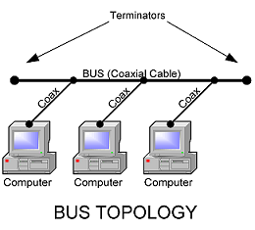
BUS TOPOLOGY
single wire (coaxial),
physical media is shared
only one can transmit
all devices hear all
communication
collision can occur
modern installations
use star

Slide 5
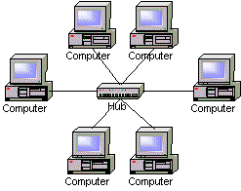
STAR TOPOLOGY
the most common network topology
devices connected to a central connection point
hub repalced switch

Slide 6
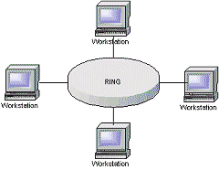
RING TOPOLOGY
using paired physical interfaces
transmit in one direction only
similar to bus
occasionally used
high security
hard to overhead

Slide 7
POINT TO POINT
often connection between two devices
end-to-end communications path.
only two devices on the connection

Slide 8
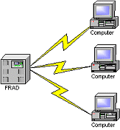
POINT TO MULTIPOINT
usually used in Wifi networks
are used in school
connects multiple network locations together

Slide 9
CONCLUSION
Most used topologies: BUS, STAR
Bus Benefits: Disavantages
cheap historical
easy to make
Star Benefits: Disavantages
fast costly
universal

Slide 10
Information Sources
Book : TCP/IP Networking by Mitch Tulloch
Web Page: http://www.cisco.netacad.net

Slide 11
Thanks for your attention.
THE END

